Slide 1
Chapter 6
Responsive Design Part 2: Designing for Tablet and Desktop Devices

Slide 2
Chapter Objectives
You will have mastered the material in this chapter when you can:
Identify and use media query expressions
Explain the design principles of a tablet website
Insert a media query to target tablet viewports
Create style rules for tablet viewports
Explain the design principles of a desktop website
Insert a media query and create style rules to target desktop viewports

Slide 3
Chapter Objectives (continued)
Insert a media query and create a style rule for large desktop viewports
Create a media query for print
Identify and modify breakpoints
Describe and add dynamic pseudo-classes to a website
Explain linear and radial gradients
Apply a linear gradient to a webpage for a desktop viewport

Slide 4
Introduction
Design process for tablet and desktop displays allows flexibility with the webpage layout
A tablet design can use a two-column layout, while a desktop design can use a multicolumn layout
Designing layouts for tablet and desktop displays is simplified through the use of media queries
Media queries are essential to responsive web design because they let you customize layouts for various viewport sizes

Slide 5
Project — Use Media Queries to Design for Tablet and Desktop Viewports
Roadmap
Add tablet media query and styles
Add desktop media query and styles
Modify viewport breakpoints
Insert and style pseudo-classes
Add a linear gradient

Slide 6
Using Media Queries
Media query
Detects the media type and capabilities of the device that the browser is running on
Applies styles that work well for that situation, based on the information provided
Applies styles to move, hide, or display content on the page, change text or colors, or add any other styles to make the page easier to read in a particular situation

Slide 7
Using Media Queries (continued 1)
Basic example of a media query inserted into the link tag of an HTML page
<link rel="stylesheet“ href="css/styles.css“ media="screen">
<link rel="stylesheet“ href="css/stylesprint.css“
media="print">

Slide 8
Using Media Queries (continued 2)
Breakpoints
Set to understand the code and syntax of how a media query detects viewport size
Point at which a webpage is required to change
Where different styles are applied to the webpage to cause it to change in a way that makes it easier to read and navigate for a particular viewport

Slide 9
Using Media Queries (continued 3)
Device | Minimum Viewport Width | Maximum Viewport Width
Small smartphones | 320px | 480px
Larger smartphones and tablets | 481px | 768px
Tablets in landscape orientation, laptops, and small desktop monitors | 769px | 1279px
Large desktop monitors | 1280px | NA
Table 6–1 Common Viewport Breakpoints

Slide 10
Media Query Expressions
Media queries can use a logical expressions to test whether a viewport has reached a particular breakpoint
Includes the name of a media query feature, a characteristic of the environment, and a breakpoint value to be tested
If the logical expression evaluates to “true,” the media query applies the styles that follow

Slide 11
Media Query Expressions (continued 1)
Media query can also test for both minimum and maximum breakpoints
Example:
<link rel="stylesheet" href="css/styles-tablet.css "media="screen and (min-width: 481px) and (max-width: 768px)">
The code directs browsers to apply the styles-tablet.css stylesheet in the css folder when screens have a viewport width between 481px and 768px
When testing for minimum and maximum widths, the word “and” separates each part of the media attribute value

Slide 12
Media Query Expressions (continued 2)
Another way to implement media queries is to code them directly into a single CSS file using the @media rule
Most common types are screen, print, and all

Slide 13
Media Query Expressions (continued 3)
Feature | Description
max-width min-width | Width of the viewport in pixels
max-resolution min-resolution | Resolution of the output device in dots per inch or dots per centimeter
max-height min-height | Height of the viewport in pixels
orientation | Orientation of the device (landscape or portrait)
Table 6–2 Common Media Query Features

Slide 14
Adding Media Queries to an External Style Sheet
Mobile-first strategy
Mobile styles are listed first as they are the default styles
Media queries are used to add styles for larger viewports, progressing from tablet to desktop
Styles created for the smaller viewports apply to larger viewports by default
To modify the appearance of an element for a larger viewport, a media query is created for the larger viewport, and then a new style is created

Slide 15
Designing for Tablet Viewports
With so many tablet sizes, it is difficult to design a “one size fits all” layout for a tablet device
With the use of responsive web design and media queries, designing multiple tablet layouts is not required
If a particular tablet device has a viewport smaller than the minimum size specified in the media query, the layout will default to the mobile viewport layout

Slide 16
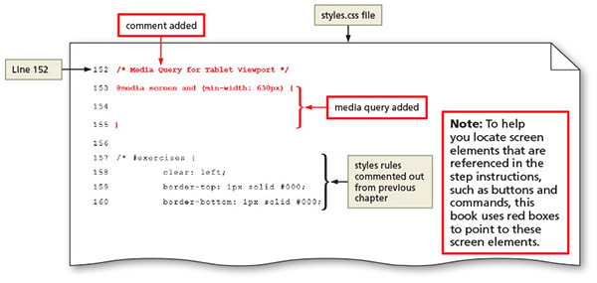
Designing for Tablet Viewports (continued 1)
Figure 6–3

Slide 17
Designing for Tablet Viewports (continued 2)
Page design for a tablet viewport
When designing for a tablet viewport
Maintain the same color scheme, typography, and general look of the website
Website should look the same from viewport to viewport; only thing that should change is layout and placement of content
To determine ideal layout for a website’s tablet viewport, review the mobile site to confirm where the content should be added and if any content should be hidden

Slide 18
Designing for Tablet Viewports (continued 3)
Navigation design for a tablet viewport
It is not necessary to maintain a vertical list of navigation buttons as a tablet screen is larger than a smartphone screen
Align the navigation buttons in a horizontal line; this frees space for the main content below the navigation area, improving its visibility by displaying it in the middle of the screen
Create a style rule to display the navigation list items as a single horizontal line when displayed in a tablet viewport
Add other properties and values that override the defaults already set for the mobile viewport

Slide 19
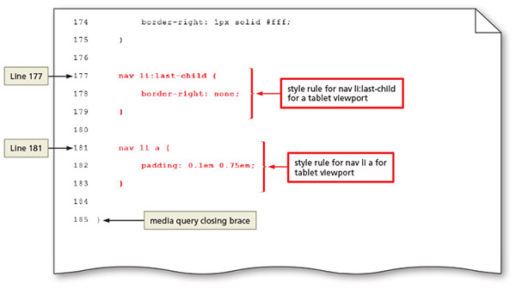
Designing for Tablet Viewports (continued 4)
Figure 6–10

Slide 20
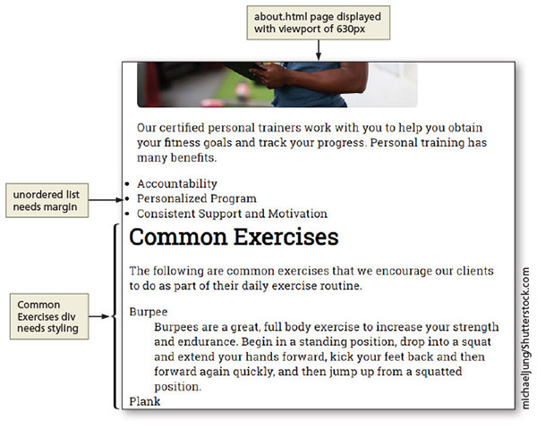
Designing for Tablet Viewports (continued 5)
About Us page design for a tablet viewport
Figure 6–12

Slide 21
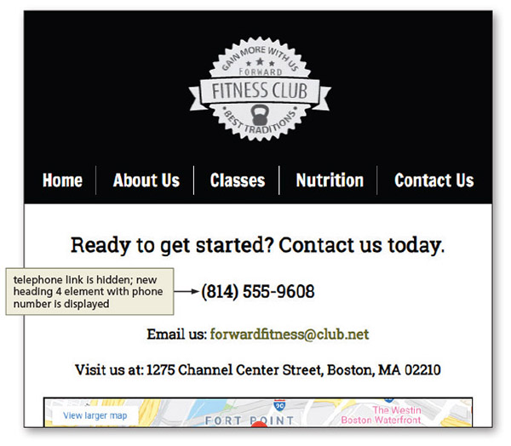
Designing for Tablet Viewports (continued 6)
Contact Us page design for a tablet viewport
Figure 6–21

Slide 22
Designing for Desktop Viewports
Principles of desktop viewport design
Use simple, intuitive navigation, clear images, and typography and apply the same color scheme
Maintain the same look and feel of the site, but change some formatting to best accommodate the desktop viewport
Provides an opportunity for a multiple-column layout

Slide 23
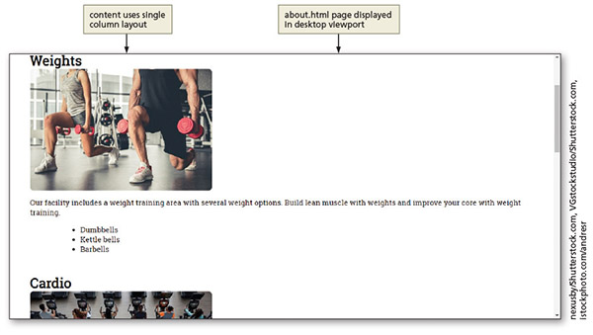
Designing for Desktop Viewports (continued 1)
About Us page design for a desktop viewport
Figure 6–36

Slide 24
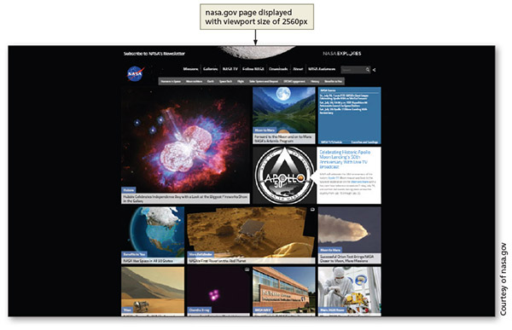
Designing for Desktop Viewports (continued 2)
Media query for large viewports
Figure 6–39

Slide 25
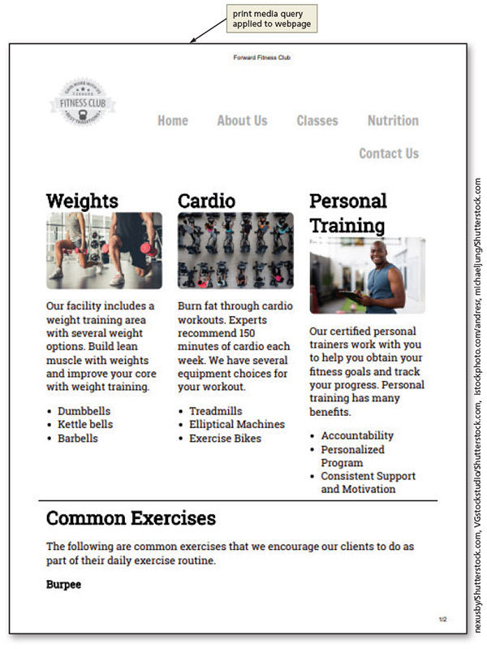
Designing for Desktop Viewports (continued 3)
Media query for print
Figure 6–47

Slide 26
Modifying Breakpoints
Breakpoint is the point at which different styles are applied to a webpage depending on the viewport
Determined by the content on the page

Slide 27
Using Dynamic Pseudo-Classes
Pseudo-classes allow changes to the style of a link based on four link states: link, visited, hover, and active
Must be used in the following order: link, visited, hover, active

Slide 28
Using Dynamic Pseudo-Classes (continued 1)
Dynamic Pseudo-Class | Used to Style
:link | Unvisited link
:visited | Link that has been clicked
:hover | Link when the mouse is hovering over it
:active | Link at the moment it is clicked
Table 6–3 Dynamic Pseudo-Classes

Slide 29
Using Dynamic Pseudo-Classes (continued 2)
A pseudo-class is attached to a selector with a colon to specify a state or relation to the selector to give the web developer more control over that selector
A unique style for normal, visited, hover, and active links is defined by creating four separate style rules with a:link, a:visited, a:hover, and a:active as the selectors

Slide 30
Using Dynamic Pseudo-Classes (continued 3)
It is not necessary to use all of the pseudo-classes
If omitted from the design, it is important to maintain the same order of the pseudo-class styles in the CSS code
Often used in a desktop viewport
Not used in mobile and tablet devices as they do not have a hover or a click option

Slide 31
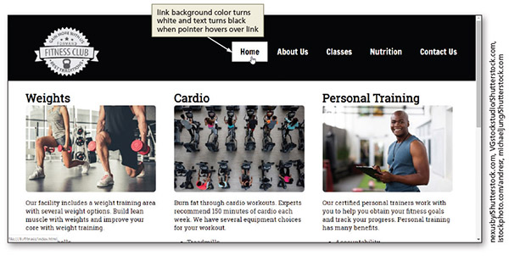
Using Dynamic Pseudo-Classes (continued 4)
Figure 6–54

Slide 32
Using Gradients
Gradient is a gradual transition from one color to another
CSS has two types
Linear gradient
Can transition from several different angles
Default transition is from the top to the bottom
Can also transition up, left, right, or diagonally

Slide 33
Using Gradients (continued 1)
Radial gradients
Specified by their center
Color begins in the center and transitions in a radial direction to another color or colors
At least two colors must be specified

Slide 34
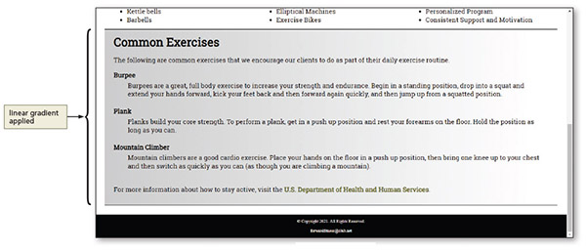
Using Gradients (continued 2)
Figure 6–56

Slide 35
Chapter Summary
In this chapter, you:
Created media queries to target tablet and desktop viewports
Created style rules to format web content displayed on tablet and desktop devices
Modified the media query breakpoints to maintain the integrity of the navigation design
Enhanced the navigation links with pseudo-classes
Added a linear gradient to the body of the website

